Slide 1
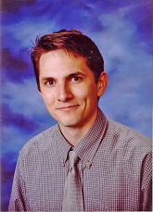
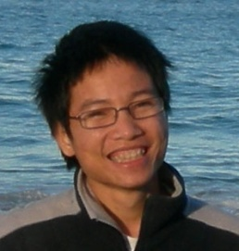

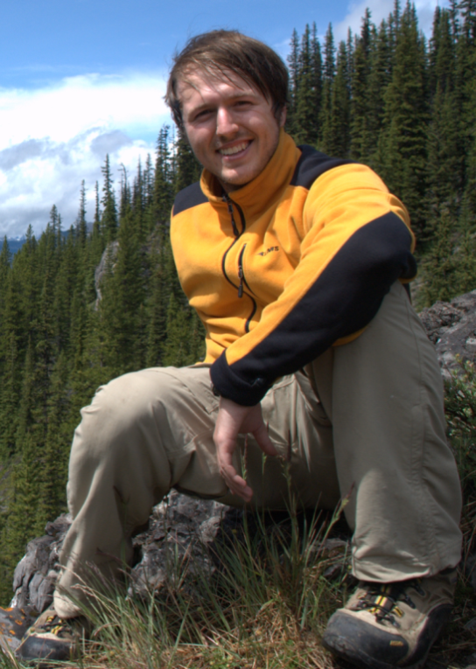
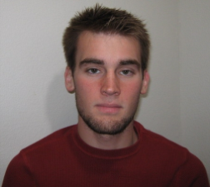
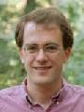

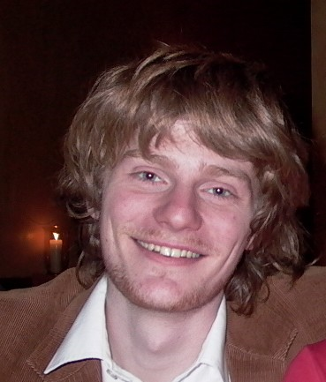
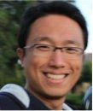
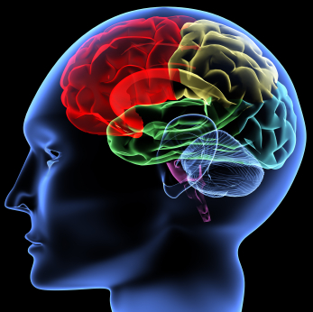
Machine Learning and AI
via Brain simulations
Andrew Ng
Stanford University
Thanks to:
Adam Coates Quoc Le Honglak Lee Andrew Saxe Andrew Maas Chris Manning Jiquan Ngiam Richard Socher Will Zou
Google: Kai Chen, Greg Corrado, Jeff Dean, Matthieu Devin, Andrea Frome, Rajat Monga, Marc’Aurelio Ranzato, Paul Tucker, Kay Le
Notes:
NVIDIA or ATI will be future of AI. Probably NVIDIA.

Slide 2
This talk: Deep Learning
Using brain simulations:
- Make learning algorithms much better and easier to use.
- Make revolutionary advances in machine learning and AI.
Vision shared with many researchers:
E.g., Samy Bengio, Yoshua Bengio, Tom Dean, Jeff Dean, Nando de Freitas, Jeff Hawkins, Geoff Hinton, Quoc Le, Yann LeCun, Honglak Lee, Tommy Poggio, Marc’Aurelio Ranzato, Ruslan Salakhutdinov, Josh Tenenbaum, Kai Yu, Jason Weston, ….
I believe this is our best shot at progress towards real AI.

Slide 3
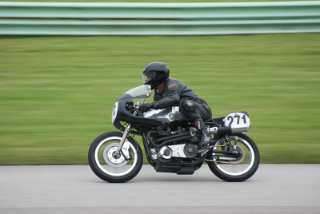
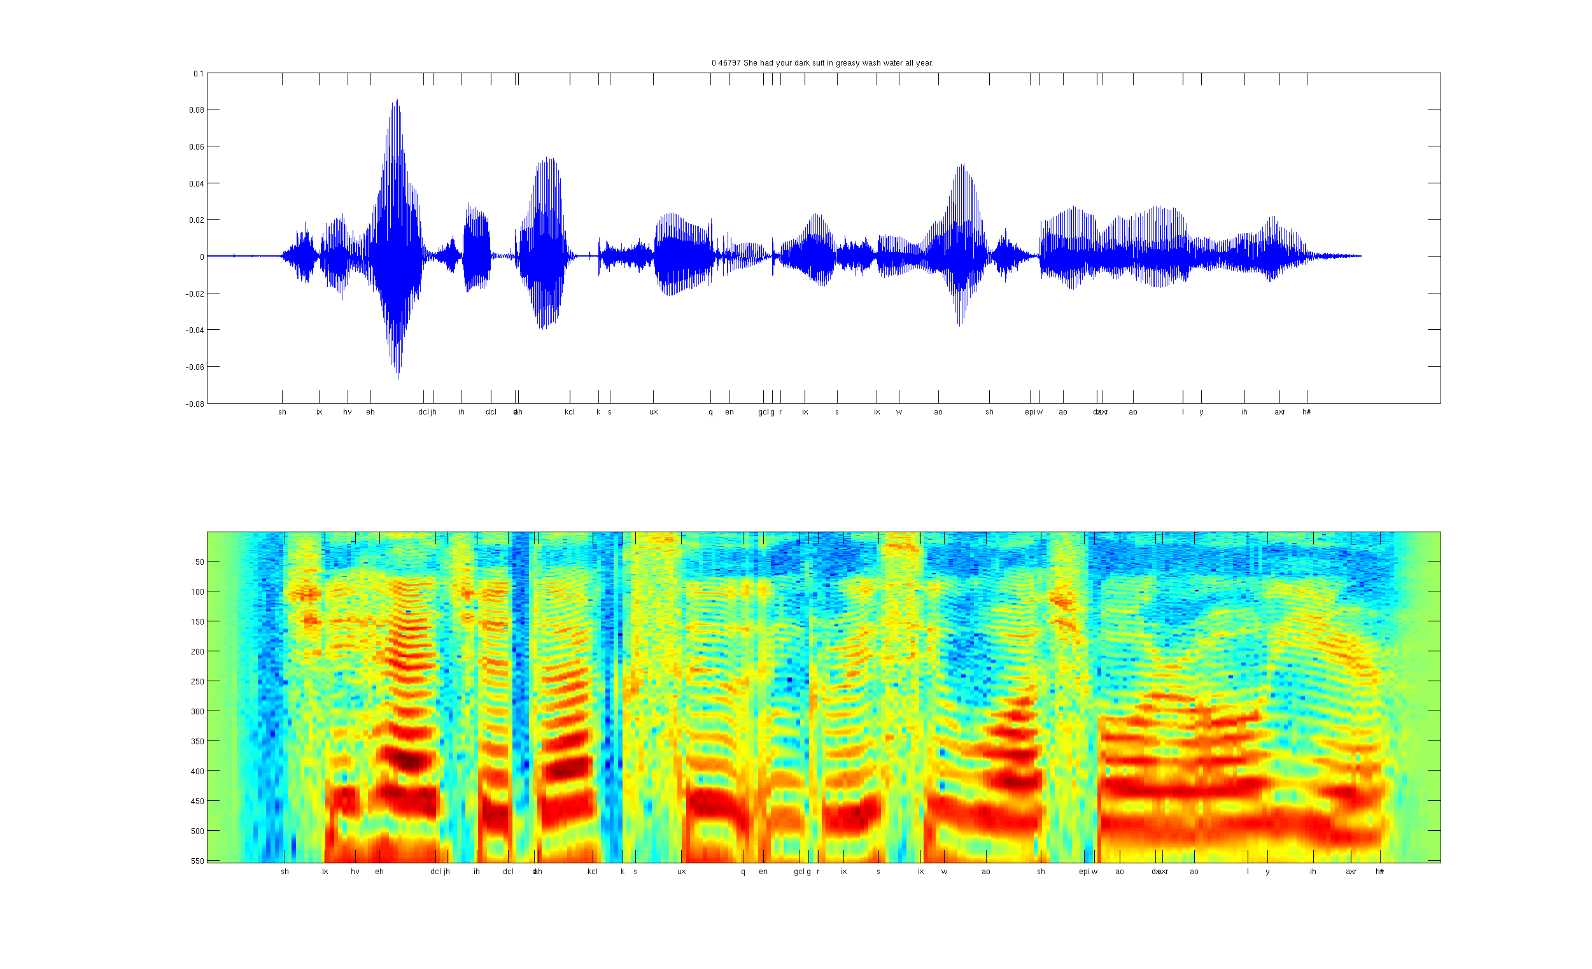


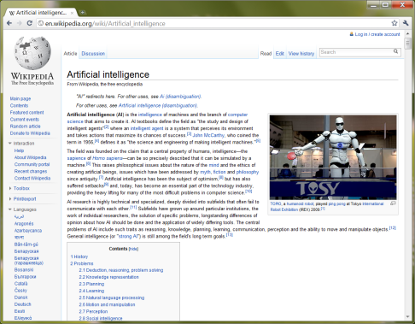
What do we want computers to do with our data?
Label: “Motorcycle”
Suggest tags
Image search
…
Images/video
Audio
Text
Speech recognition
Music classification
Speaker identification
…
Web search
Anti-spam
Machine translation
…

Slide 4
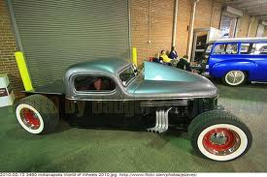
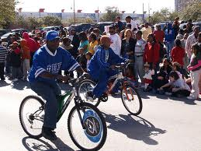
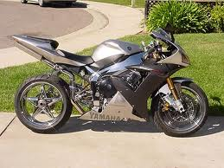
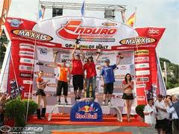
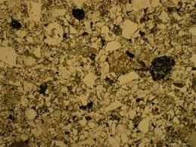
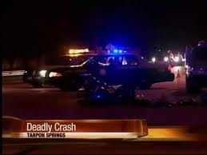
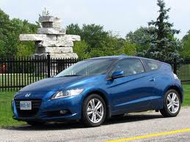
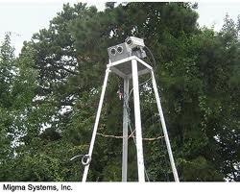
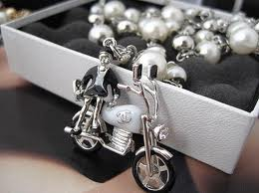
Computer vision is hard!
Motorcycle
Motorcycle
Motorcycle
Motorcycle
Motorcycle
Motorcycle
Motorcycle
Motorcycle
Motorcycle
Notes:
Good faith effort to implement state-of-the-art.
Cluttered scenes.

Slide 5
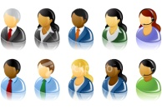
What do we want computers to do with our data?
Label: “Motorcycle”
Suggest tags
Image search
…
Images/video
Audio
Text
Speech recognition
Speaker identification
Music classification
…
Web search
Anti-spam
Machine translation
…
Machine learning performs well on many of these problems, but is a lot of work. What is it about machine learning that makes it so hard to use?

Slide 6
Machine learning for image classification
“Motorcycle”
This talk: Develop ideas using images and audio. Ideas apply to other problems (e.g., text) too.

Slide 7
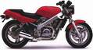
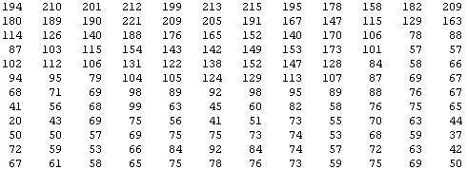
Why is this hard?
You see this:
But the camera sees this:

Slide 8
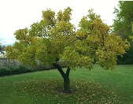
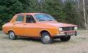

Machine learning and feature representations
pixel 1
Learning
algorithm
pixel 2
Input
Motorbikes
Raw image
“Non”-Motorbikes
pixel 2
pixel 1

Slide 9
Machine learning and feature representations
pixel 1
Learning
algorithm
pixel 2
Input
Motorbikes
Raw image
“Non”-Motorbikes
pixel 2
pixel 1

Slide 10
Machine learning and feature representations
pixel 1
Learning
algorithm
pixel 2
Input
Motorbikes
Raw image
“Non”-Motorbikes
pixel 2
pixel 1

Slide 11
What we want
handlebars
Feature representation
Learning
algorithm
wheel
Input
E.g., Does it have Handlebars? Wheels?
Motorbikes
Raw image
“Non”-Motorbikes
Features
pixel 2
Wheels
pixel 1
Handlebars

Slide 12
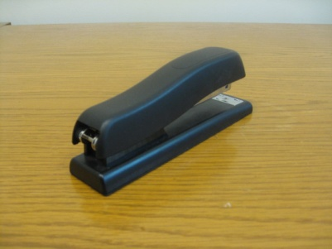
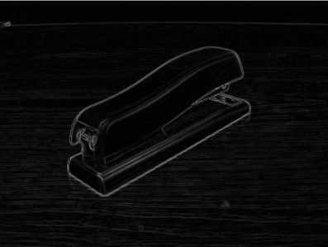




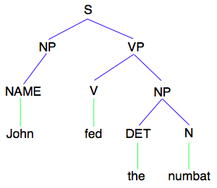
How is computer perception done?
Images/video
Image
Vision features
Detection
Audio
Image
Low-level features
Grasp point
Audio
Audio features
Speaker ID
Text classification, Machine translation, Information retrieval, ....
Text
Text
Text features

Slide 13
Feature representations
Feature Representation
Learning
algorithm
Input
Notes:
Where do we get these low-level representations from?

Slide 14
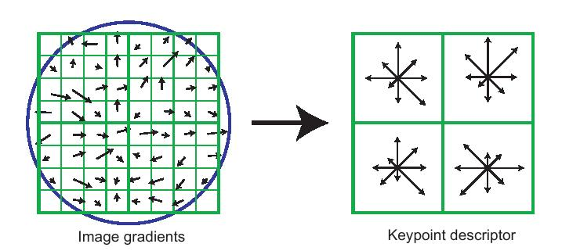
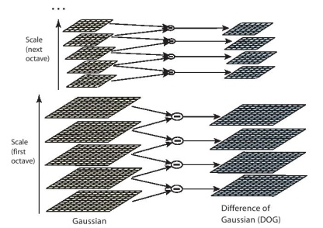
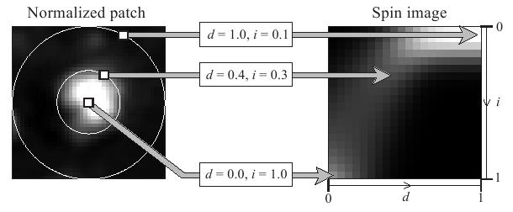
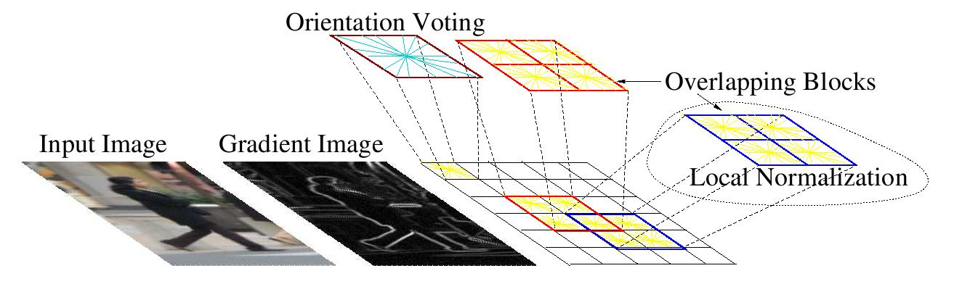
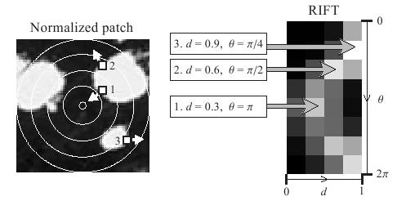
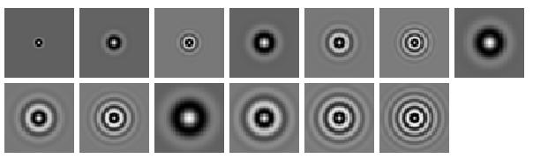
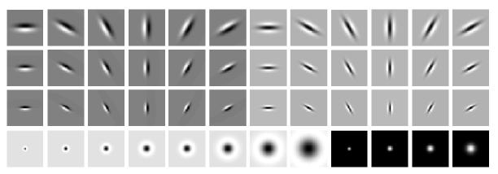
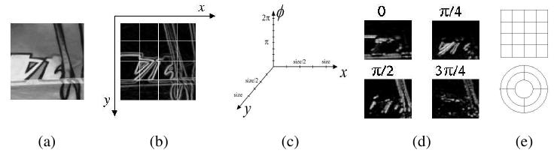
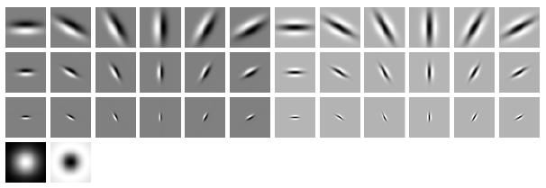
Computer vision features
SIFT
Spin image
HoG
RIFT
Textons
GLOH

Slide 15
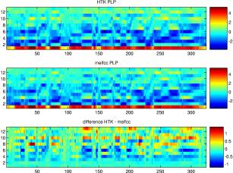
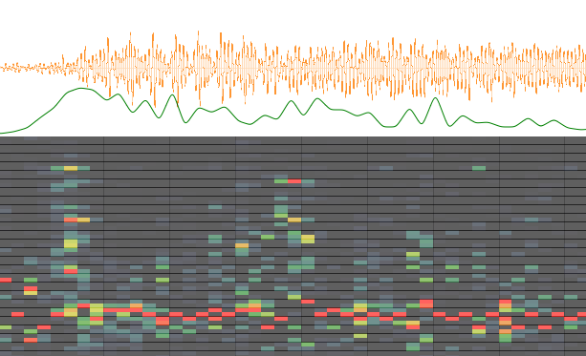
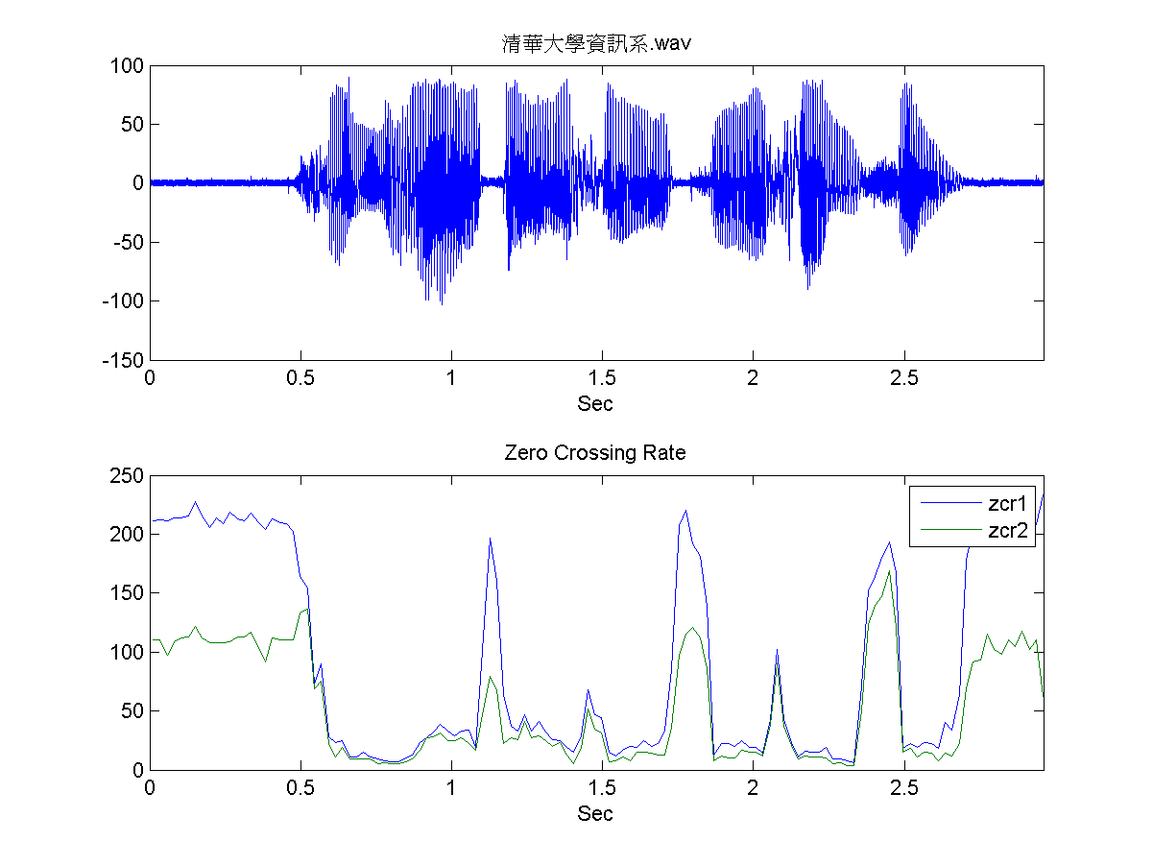
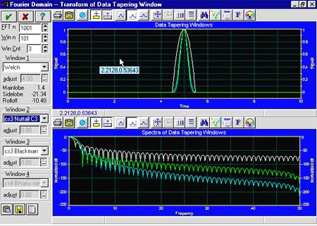
Audio features
Spectrogram
MFCC
Flux
ZCR
Rolloff

Slide 16
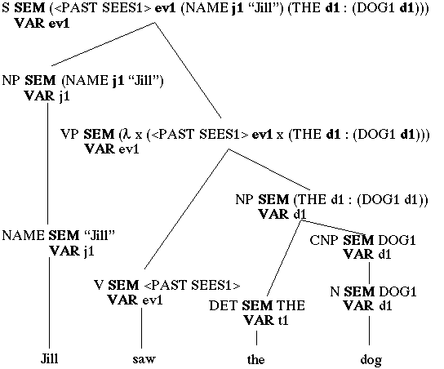
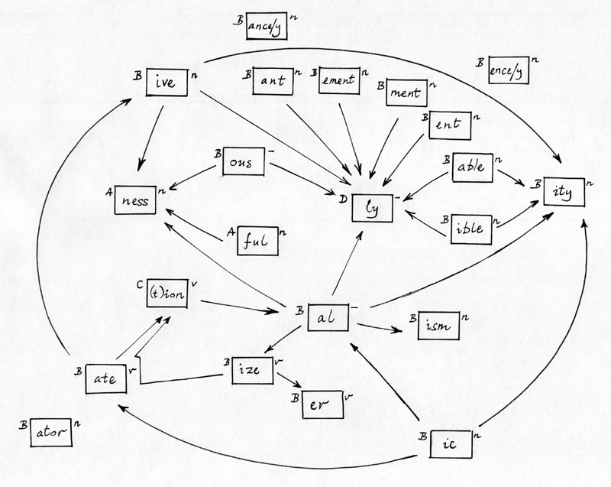
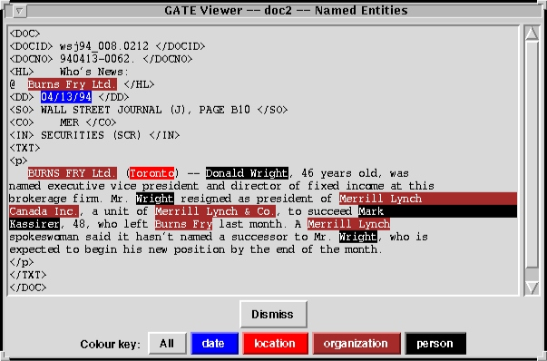
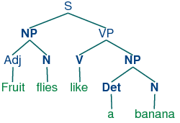
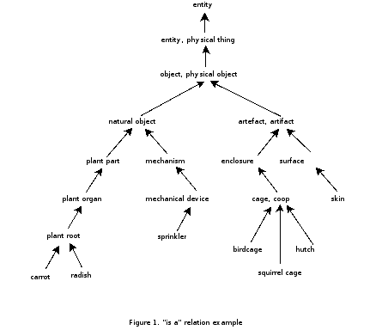
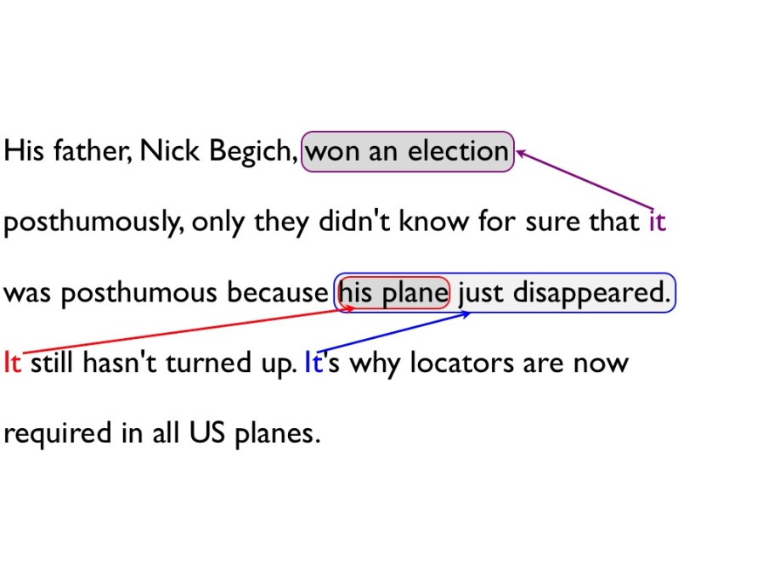
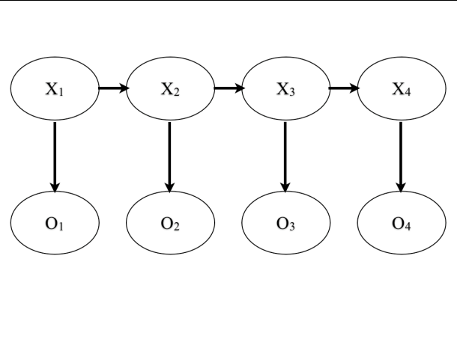
NLP features
Named entity recognition
Stemming
Parser features
Coming up with features is difficult, time-consuming, requires expert knowledge.
“Applied machine learning” is basically feature engineering.
Anaphora
Part of speech
Ontologies (WordNet)

Slide 17
Feature representations
Input
Feature Representation
Learning
algorithm
Notes:
Where do we get these low-level representations from?

Slide 18

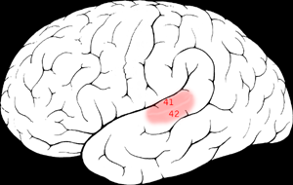

The “one learning algorithm” hypothesis
Auditory Cortex
Auditory cortex learns to see
[Roe et al., 1992]

Slide 19
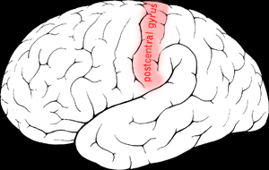

The “one learning algorithm” hypothesis
Somatosensory Cortex
Somatosensory cortex learns to see
[Metin & Frost, 1989]

Slide 20






Sensor representations in the brain
Seeing with your tongue
Human echolocation (sonar)
Haptic belt: Direction sense
Implanting a 3rd eye
[BrainPort; Welsh & Blasch, 1997; Nagel et al., 2005; Constantine-Paton & Law, 2009]

Slide 21

Feature learning problem
Given a 14x14 image patch x, can represent it using 196 real numbers.
Problem: Can we find a learn a better feature vector to represent this?
255
98
93
87
89
91
48
…

Slide 22

First stage of visual processing: V1
V1 is the first stage of visual processing in the brain.
Neurons in V1 typically modeled as edge detectors:
Neuron #1 of visual cortex
(model)
Neuron #2 of visual cortex
(model)
Notes:
http://www.ldeo.columbia.edu/4d4/wavelets/dm.html

Slide 23

Learning sensor representations
Sparse coding (Olshausen & Field,1996)
Input: Images x⁽¹⁾, x⁽²⁾, …, x^{(m)} (each in R^{n x n})
Learn: Dictionary of bases φ₁, φ₂, …, φ_{k} (also R^{n x n}), so that each input x can be approximately decomposed as:
x ∑ a_{j} φ_{j}
s.t. a_{j}’s are mostly zero (“sparse”)
Use to represent 14x14 image patch succinctly, as [a₇=0.8, a₃₆=0.3, a₄₁ = 0.5]. I.e., this indicates which “basic edges” make up the image.
^{k}
^{j=1}
[NIPS 2006, 2007]

Slide 24







Sparse coding illustration
Natural Images
Learned bases (φ_{1 , …,} φ₆₄): “Edges”
Test example
≈ 0.8 * + 0.3 * + 0.5 *
x ≈ 0.8 * φ₃₆ + 0.3 * φ₄₂ + 0.5 * φ₆₃
[a₁, …, a₆₄] = [0, 0, …, 0, 0.8, 0, …, 0, 0.3, 0, …, 0, 0.5, 0]
(feature representation)
More succinct, higher-level, representation.

Slide 25








More examples
Represent as: [a₁₅=0.6, a₂₈=0.8, a₃₇ = 0.4].
Represent as: [a₅=1.3, a₁₈=0.9, a₂₉ = 0.3].
0.6 * + 0.8 * + 0.4 *
φ₁₅ φ₂₈ φ₃₇
1.3 * + 0.9 * + 0.3 *
φ₅ φ₁₈ φ₂₉
Method “invents” edge detection.
Automatically learns to represent an image in terms of the edges that appear in it. Gives a more succinct, higher-level representation than the raw pixels.
Quantitatively similar to primary visual cortex (area V1) in brain.

Slide 26
Sparse coding applied to audio
Image shows 20 basis functions learned from unlabeled audio.
[Evan Smith & Mike Lewicki, 2006]

Slide 27
Sparse coding applied to audio
Image shows 20 basis functions learned from unlabeled audio.
[Evan Smith & Mike Lewicki, 2006]

Slide 28
Somatosensory (touch) processing
Example learned representations
Biological data
Learning Algorithm
[Andrew Saxe]

Slide 29

Learning feature hierarchies
Higher layer
(Combinations of edges;
cf. V2)
a₁
a₂
a₃
“Sparse coding”
(edges; cf. V1)
x₁
x₂
x₃
x₄
Input image (pixels)
[Technical details: Sparse autoencoder or sparse version of Hinton’s DBN.]
[Lee, Ranganath & Ng, 2007]

Slide 30
Learning feature hierarchies
Higher layer
(Model V3?)
Higher layer
(Model V2?)
a₁
a₂
a₃
Model V1
x₁
x₂
x₃
x₄
Input image
[Technical details: Sparse autoencoder or sparse version of Hinton’s DBN.]
[Lee, Ranganath & Ng, 2007]

Slide 31


Hierarchical Sparse coding (Sparse DBN): Trained on face images
object models
object parts
(combination
of edges)
Training set: Aligned
images of faces.
edges
pixels
[Honglak Lee]

Slide 32
Machine learning applications

Slide 33
















Unsupervised feature learning (Self-taught learning)
Motorcycles
Not motorcycles
Testing:
What is this?
…
Unlabeled images
[Lee, Raina and Ng, 2006; Raina, Lee, Battle, Packer & Ng, 2007]
[This uses unlabeled data. One can learn the features from labeled data too.]

Slide 34

Video Activity recognition (Hollywood 2 benchmark)
Method | Accuracy
Hessian + ESURF [Williems et al 2008] | 38%
Harris3D + HOG/HOF [Laptev et al 2003, 2004] | 45%
Cuboids + HOG/HOF [Dollar et al 2005, Laptev 2004] | 46%
Hessian + HOG/HOF [Laptev 2004, Williems et al 2008] | 46%
Dense + HOG / HOF [Laptev 2004] | 47%
Cuboids + HOG3D [Klaser 2008, Dollar et al 2005] | 46%
Unsupervised feature learning (our method) | 52%
Unsupervised feature learning significantly improves on the previous state-of-the-art.
[Le, Zhou & Ng, 2011]

Slide 35
Audio
TIMIT Phone classification | Accuracy
Prior art (Clarkson et al.,1999) | 79.6%
Stanford Feature learning | 80.3%
TIMIT Speaker identification | Accuracy
Prior art (Reynolds, 1995) | 99.7%
Stanford Feature learning | 100.0%
Images
CIFAR Object classification | Accuracy
Prior art (Ciresan et al., 2011) | 80.5%
Stanford Feature learning | 82.0%
NORB Object classification | Accuracy
Prior art (Scherer et al., 2010) | 94.4%
Stanford Feature learning | 95.0%
Galaxy
Video
Hollywood2 Classification | Accuracy
Prior art (Laptev et al., 2004) | 48%
Stanford Feature learning | 53%
YouTube | Accuracy
Prior art (Liu et al., 2009) | 71.2%
Stanford Feature learning | 75.8%
KTH | Accuracy
Prior art (Wang et al., 2010) | 92.1%
Stanford Feature learning | 93.9%
UCF | Accuracy
Prior art (Wang et al., 2010) | 85.6%
Stanford Feature learning | 86.5%
Text/NLP
Multimodal (audio/video)
AVLetters Lip reading | Accuracy
Prior art (Zhao et al., 2009) | 58.9%
Stanford Feature learning | 65.8%
Paraphrase detection | Accuracy
Prior art (Das & Smith, 2009) | 76.1%
Stanford Feature learning | 76.4%
Sentiment (MR/MPQA data) | Accuracy
Prior art (Nakagawa et al., 2010) | 77.3%
Stanford Feature learning | 77.7%
Notes:
Other SOTA performance records held by Kai Yu, Geoff Hinton.

Slide 36
How do you build a high accuracy learning system?
Notes:
NVIDIA or ATI will be future of AI. Probably NVIDIA.

Slide 37

Supervised Learning: Labeled data
Choices of learning algorithm:
Memory based
Winnow
Perceptron
Naïve Bayes
SVM
….
What matters the most?
Accuracy
Training set size (millions)
[Banko & Brill, 2001]
“It’s not who has the best algorithm that wins. It’s who has the most data.”

Slide 38

Unsupervised Learning
Large numbers of features is critical. The specific learning algorithm is important, but ones that can scale to many features also have a big advantage.
[Adam Coates]

Slide 40
Learning from Labeled data

Slide 41
Model
Training Data

Slide 42
Model
Machine (Model Partition)
Training Data

Slide 43
Model
Machine (Model Partition)
Training Data
Core

Slide 44
Basic DistBelief Model Training
Model
Unsupervised or Supervised Objective
Minibatch Stochastic Gradient Descent (SGD)
Model parameters sharded by partition
10s, 100s, or 1000s of cores per model
Training Data

Slide 45
Basic DistBelief Model Training
Model
Parallelize across ~100 machines (~1600 cores).
But training is still slow with large data sets.
Add another dimension of parallelism, and have multiple model instances in parallel.
Training Data

Slide 46
Two Approaches to Multi-Model Training
(1) Downpour: Asynchronous Distributed SGD
(2) Sandblaster: Distributed L-BFGS

Slide 47
Asynchronous Distributed Stochastic Gradient Descent
p’ = p + ∆p
Parameter Server
p’’ = p’ + ∆p’
∆p
∆p’
p’
p
Model
Data

Slide 48
Asynchronous Distributed Stochastic Gradient Descent
Parameter Server
p’ = p + ∆p
∆p
p’
Model
Workers
Data
Shards

Slide 49
Asynchronous Distributed Stochastic Gradient Descent
Parameter Server
Slave models
Data Shards
From an engineering standpoint, superior to a single model with the same number of total machines:
Better robustness to individual slow machines
Makes forward progress even during evictions/restarts

Slide 50
L-BFGS: a Big Batch Alternative to SGD.
Async-SGD
first derivatives only
many small steps
mini-batched data (10s of examples)
tiny compute and data requirements per step
theory is dicey
at most 10s or 100s of model replicas
L-BFGS
first and second derivatives
larger, smarter steps
mega-batched data (millions of examples)
huge compute and data requirements per step
strong theoretical grounding
1000s of model replicas

Slide 51
L-BFGS: a Big Batch Alternative to SGD.
Leverages the same parameter server implementation as Async-SGD, but uses it to shard computation within a mega-batch.
Coordinator
(small messages)
Some current numbers:
20,000 cores in a single cluster
up to 1 billion data items / mega-batch (in ~1 hour)
Parameter Server
Model
Workers
Data
More network friendly at large scales than Async-SGD.
The possibility of running on multiple data centers...

Slide 52
Acoustic Modeling for Speech Recognition
8000-label Softmax
One or more hidden layers
of a few thousand nodes each.
11 Frames of 40-value Log Energy Power Spectra and the label for central frame

Slide 53

Acoustic Modeling for Speech Recognition
Async SGD and L-BFGS can both speed up model training.
To reach the same model quality DistBelief reached in 4 days took 55 days using a GPU....
DistBelief can support much larger models than a GPU (useful for unsupervised learning).

Slide 55

Speech recognition on Android

Slide 56

Application to Google Streetview
[with Yuval Netzer, Julian Ibarz]

Slide 57
Learning from Unlabeled data
Notes:
NVIDIA or ATI will be future of AI. Probably NVIDIA.

Slide 58
Supervised Learning
Choices of learning algorithm:
Memory based
Winnow
Perceptron
Naïve Bayes
SVM
….
What matters the most?
Accuracy
Training set size (millions)
[Banko & Brill, 2001]
“It’s not who has the best algorithm that wins. It’s who has the most data.”

Slide 59
Unsupervised Learning
Large numbers of features is critical. The specific learning algorithm is important, but ones that can scale to many features also have a big advantage.
[Adam Coates]

Slide 60
50 thousand 32x32 images
10 million parameters

Slide 61
10 million 200x200 images
1 billion parameters

Slide 62


Training procedure
What features can we learn if we train a massive model on a massive amount of data. Can we learn a “grandmother cell”?
Train on 10 million images (YouTube)
1000 machines (16,000 cores) for 1 week.
Test on novel images
Training set (YouTube) Test set (FITW + ImageNet)

Slide 63


The face neuron
Top stimuli from the test set
Optimal stimulus
by numerical optimization
Le, et al., Building high-level features using large-scale unsupervised learning. ICML 2012

Slide 64

Random distractors
Faces
Frequency
Feature value
Le, et al., Building high-level features using large-scale unsupervised learning. ICML 2012

Slide 65




Invariance properties
Feature response
Feature response
0 pixels
20 pixels
0 pixels
20 pixels
Horizontal shifts
Vertical shifts
Feature response
Feature response
o
o
0
90
0.4x
1x
1.6x
3D rotation angle
Scale factor
Le, et al., Building high-level features using large-scale unsupervised learning. ICML 2012

Slide 66




Cat neuron
Top Stimuli from the test set
Average of top stimuli from test set
[Raina, Madhavan and Ng, 2008]

Slide 67





Best stimuli
Feature 1
Feature 2
Feature 3
Feature 4
Feature 5
Le, et al., Building high-level features using large-scale unsupervised learning. ICML 2012
Input to another layer above
(image with 8 channels)
Number of output
channels = 8
LCN Size = 5
H
Pooling Size = 5
Number
of maps = 8
One layer
W
RF size = 18
Number of input
channels = 3
Image Size = 200

Slide 68




Best stimuli
Feature 6
Feature 7
Feature 8
Feature 9
Le, et al., Building high-level features using large-scale unsupervised learning. ICML 2012
Input to another layer above
(image with 8 channels)
Number of output
channels = 8
LCN Size = 5
H
Pooling Size = 5
Number
of maps = 8
One layer
W
RF size = 18
Number of input
channels = 3
Image Size = 200

Slide 69





Best stimuli
Feature 10
Feature 11
Feature 12
Feature 13
Le, et al., Building high-level features using large-scale unsupervised learning. ICML 2012
Input to another layer above
(image with 8 channels)
Number of output
channels = 8
LCN Size = 5
H
Pooling Size = 5
Number
of maps = 8
One layer
W
RF size = 18
Number of input
channels = 3
Image Size = 200

Slide 70
ImageNet classification
22,000 categories
14,000,000 images
Hand-engineered features (SIFT, HOG, LBP),
Spatial pyramid, SparseCoding/Compression
Le, et al., Building high-level features using large-scale unsupervised learning. ICML 2012

Slide 71





ImageNet classification: 22,000 classes
…
smoothhound, smoothhound shark, Mustelus mustelus
American smooth dogfish, Mustelus canis
Florida smoothhound, Mustelus norrisi
whitetip shark, reef whitetip shark, Triaenodon obseus
Atlantic spiny dogfish, Squalus acanthias
Pacific spiny dogfish, Squalus suckleyi
hammerhead, hammerhead shark
smooth hammerhead, Sphyrna zygaena
smalleye hammerhead, Sphyrna tudes
shovelhead, bonnethead, bonnet shark, Sphyrna tiburo
angel shark, angelfish, Squatina squatina, monkfish
electric ray, crampfish, numbfish, torpedo
smalltooth sawfish, Pristis pectinatus
guitarfish
roughtail stingray, Dasyatis centroura
butterfly ray
eagle ray
spotted eagle ray, spotted ray, Aetobatus narinari
cownose ray, cow-nosed ray, Rhinoptera bonasus
manta, manta ray, devilfish
Atlantic manta, Manta birostris
devil ray, Mobula hypostoma
grey skate, gray skate, Raja batis
little skate, Raja erinacea
…
Stingray
Mantaray

Slide 72




Unsupervised feature learning (Self-taught learning)
Motorcycles
Not motorcycles
Testing:
What is this?
…
Unlabeled images
[Lee, Raina and Ng, 2006; Raina, Lee, Battle, Packer & Ng, 2007]
[This uses unlabeled data. One can learn the features from labeled data too.]

Slide 73
0.005%
9.5%
?
Random guess
State-of-the-art
(Weston, Bengio ‘11)
Feature learning
From raw pixels
Le, et al., Building high-level features using large-scale unsupervised learning. ICML 2012

Slide 74
0.005%
9.5%
21.3%
Random guess
State-of-the-art
(Weston, Bengio ‘11)
Feature learning
From raw pixels
Le, et al., Building high-level features using large-scale unsupervised learning. ICML 2012

Slide 75

Scaling up with HPC GPU cluster
“Cloud” infrastructure
GPUs with CUDA
Many inexpensive nodes. Comm. bottlenecks, node failures.
1 very fast node. Limited memory; hard to scale out.
Network fabric
HPC cluster: GPUs with Infiniband Difficult to program---lots of MPI and CUDA code.
Notes:
Cloud infrastructure: attractive because it uses existing web-service infrastructure. Tools available (e.g., Hadoop)
GPUs with CUDA: inexpensive, very fast. But hard to use several at once---they’re so fast that networks cannot keep up with them.
Our system: a miniature supercomputer. Hard to program.

Slide 76
Stanford GPU cluster
Current system
64 GPUs in 16 machines.
Tightly optimized CUDA for Deep Learning operations.
47x faster than single-GPU implementation.
Train 11.2 billion parameter, 9 layer neural network in < 4 days.
Notes:
other notes:
Able to duplicate the google “cat” result in a few days with 3 machines.
Largest networks are > 11B parameters, trained in 3 days.

Slide 77
Language: Learning Recursive Representations

Slide 78
Feature representations of words
For each word, compute an n-dimensional feature vector for it.
[Distributional representations, or Bengio et al., 2003, Collobert & Weston, 2008.]
2-d embedding example below, but in practice use ~100-d embeddings.
5
4
3
2
1
On
8
5
0
0
0
0
1
0
0
0
0
1
0
0
0
0
0
0
2
4
Monday
x₂
Tuesday
2.1
3.3
Britain
9
2
France
9.5
1.5
Monday Britain
0 1 2 3 4 5 6 7 8 9 10
x₁
On Monday, Britain ….
Representation:
8
5
2
4
9
2
E.g., LSA (Landauer & Dumais, 1997); Distributional clustering (Brown et al., 1992; Pereira et al., 1993);

Slide 79
“Generic” hierarchy on text doesn’t make sense
Node has to represent sentence fragment “cat sat on.” Doesn’t make sense.
9
1
5
3
7
1
8
5
9
1
4
3
The cat sat
The cat on the mat.
Feature representation for words

Slide 80
What we want (illustration)
S
This node’s job is to represent
“on the mat.”
VP
PP
NP
NP
9
1
5
3
7
1
8
5
9
1
4
3
The cat sat
The cat on the mat.

Slide 81
What we want (illustration)
5
4
S
This node’s job is to represent
“on the mat.”
7
3
VP
8
3
PP
5
2
NP
3
3
NP
9
1
5
3
7
1
8
5
9
1
4
3
The cat sat
The cat on the mat.

Slide 82
What we want (illustration)
5
4
3
2
1
The day after my birthday
x₂
Monday
Tuesday
The country of my birth
Britain
France
0 1 2 3 4 5 6 7 8 9 10
x₁
3
5
9
3
8
3
9
2
5
2
3
3
2
8
3
2
g
9
2
3
2
g
9
9
3
2
8
5
2
4
9
2
8
5
9
2
2
2
The day after my birthday, …
The country of my birth…

Slide 83
Learning recursive representations
This node’s job is to represent
“on the mat.”
8
3
3
3
8
5
9
1
4
3
The cat on the mat.

Slide 84
Learning recursive representations
This node’s job is to represent
“on the mat.”
8
3
3
3
8
5
9
1
4
3
The cat on the mat.

Slide 85
Learning recursive representations
Basic computational unit: Neural Network that inputs two candidate children’s representations, and outputs:
Whether we should merge the two nodes.
The semantic representation if the two nodes are merged.
This node’s job is to represent
“on the mat.”
8
3
8
3
“Yes”
3
3
Neural
Network
8
5
9
1
4
3
The cat on the mat.
8
5
3
3

Slide 86
Parsing a sentence
5
2
0
1
0
1
0
0
3
3
Yes
No
No
No
Yes
Neural
Network
Neural
Network
Neural
Network
Neural
Network
Neural
Network
9
1
5
3
7
1
8
5
9
1
4
3
The cat sat
The cat on the mat.

Slide 87
Parsing a sentence
0
1
0
1
8
3
No
No
Yes
Neural
Network
Neural
Network
Neural
Network
5
2
3
3
9
1
5
3
7
1
8
5
9
1
4
3
The cat sat
The cat on the mat.

Slide 88
Parsing a sentence
0
1
8
3
No
Yes
Neural
Network
Neural
Network
5
2
3
3
9
1
5
3
8
5
9
1
4
3
The cat on the mat.
[Socher, Manning & Ng]

Slide 89
Parsing a sentence
5
4
7
3
8
3
5
2
3
3
9
1
5
3
7
1
8
5
9
1
4
3
The cat sat
The cat on the mat.

Slide 90
Finding Similar Sentences
Each sentence has a feature vector representation.
Pick a sentence (“center sentence”) and list nearest neighbor sentences.
Often either semantically or syntactically similar. (Digits all mapped to 2.)
Similarities | Center Sentence | Nearest Neighbor Sentences (most similar feature vector)
Bad News | Both took further hits yesterday | We 're in for a lot of turbulence ... BSN currently has 2.2 million common shares outstanding This is panic buying We have a couple or three tough weeks coming
Something said | I had calls all night long from the States, he said | Our intent is to promote the best alternative, he says We have sufficient cash flow to handle that, he said Currently, average pay for machinists is 22.22 an hour, Boeing said Profit from trading for its own account dropped, the securities firm said
Gains and good news | Fujisawa gained 22 to 2,222 | Mochida advanced 22 to 2,222 Commerzbank gained 2 to 222.2 Paris loved her at first sight Profits improved across Hess's businesses
Unknown words which are cities | Columbia , S.C | Greenville , Miss UNK , Md UNK , Miss UNK , Calif

Slide 91
Finding Similar Sentences
Similarities | Center Sentence | Nearest Neighbor Sentences (most similar feature vector)
Declining to comment = not disclosing | Hess declined to comment | PaineWebber declined to comment Phoenix declined to comment Campeau declined to comment Coastal wouldn't disclose the terms
Large changes in sales or revenue | Sales grew almost 2 % to 222.2 million from 222.2 million | Sales surged 22 % to 222.22 billion yen from 222.22 billion Revenue fell 2 % to 2.22 billion from 2.22 billion Sales rose more than 2 % to 22.2 million from 22.2 million Volume was 222.2 million shares , more than triple recent levels
Negation of different types | There's nothing unusual about business groups pushing for more government spending | We don't think at this point anything needs to be said It therefore makes no sense for each market to adopt different circuit breakers You can't say the same with black and white I don't think anyone left the place UNK UNK
People in bad situations | We were lucky | It was chaotic We were wrong People had died They still are

Slide 92
Application: Paraphrase Detection
Task: Decide whether or not two sentences are paraphrases of each other. (MSR Paraphrase Corpus)
Method | F1
Baseline | 79.9
Rus et al., (2008) | 80.5
Mihalcea et al., (2006) | 81.3
Islam et al. (2007) | 81.3
Qiu et al. (2006) | 81.6
Fernando & Stevenson (2008) (WordNet based features) | 82.4
Das et al. (2009) | 82.7
Wan et al (2006) (many features: POS, parsing, BLEU, etc.) | 83.0
Stanford Feature Learning | 83.4
Method | F1
Baseline | 57.8
Tf-idf + cosine similarity (from Mihalcea, 2006) | 75.3
Kozareva and Montoyo (2006) (lexical and semantic features) | 79.6
RNN-based Model (our work) | 79.7
Mihalcea et al. (2006) (word similarity measures: WordNet, dictionaries, etc.) | 81.3
Fernando & Stevenson (2008) (WordNet based features) | 82.4
Wan et al (2006) (many features: POS, parsing, BLEU, etc.) | 83.0

Slide 93
Discussion: Engineering vs. Data
Notes:
NVIDIA or ATI will be future of AI. Probably NVIDIA.

Slide 94
Discussion: Engineering vs. Data
Contribution to performance
Human
ingenuity
Data/
learning
Notes:
NVIDIA or ATI will be future of AI. Probably NVIDIA.

Slide 95
Discussion: Engineering vs. Data
Contribution to performance
Time
Now
Notes:
NVIDIA or ATI will be future of AI. Probably NVIDIA.

Slide 96














Deep Learning
Deep Learning: Lets learn our features.
Discover the fundamental computational principles that underlie perception.
Scaling up has been key to achieving good performance.
Didn’t talk about: Recursive deep learning for NLP.
Online machine learning class: http://ml-class.org
Online tutorial on deep learning: http://deeplearning.stanford.edu/wiki
Stanford
Adam Coates Quoc Le Honglak Lee Andrew Saxe Andrew Maas Chris Manning Jiquan Ngiam Richard Socher Will Zou
Google
Kai Chen Greg Corrado Jeff Dean Matthieu Devin Andrea Frome Rajat Monga Marc’Aurelio Paul Tucker Kay Le
Ranzato

Slide 97
END END END
Notes:
NS goal: Understanding the brain
CS/engineering goal:

Slide 99
Scaling up: Discovering object classes
[Quoc V. Le, Marc'Aurelio Ranzato, Rajat Monga, Greg Corrado, Matthieu Devin, Kai Chen, Jeff Dean]

Slide 100
Local Receptive Field networks
Machine #1
Machine #2
Machine #3
Machine #4
Sparse features
Image
Le, et al., Tiled Convolutional Neural Networks. NIPS 2010

Slide 101

Asynchronous Parallel SGD
Le, et al., Building high-level features using large-scale unsupervised learning. ICML 2012

Slide 102

Asynchronous Parallel SGD
Parameter server
Le, et al., Building high-level features using large-scale unsupervised learning. ICML 2012

Slide 103
Asynchronous Parallel SGD
Parameter server
Le, et al., Building high-level features using large-scale unsupervised learning. ICML 2012

Slide 104
Training procedure
What features can we learn if we train a massive model on a massive amount of data. Can we learn a “grandmother cell”?
Train on 10 million images (YouTube)
1000 machines (16,000 cores) for 1 week.
1.15 billion parameters
Test on novel images
Training set (YouTube) Test set (FITW + ImageNet)

Slide 105

Face neuron
Top Stimuli from the test set
Optimal stimulus by numerical optimization
[Raina, Madhavan and Ng, 2008]

Slide 106
Random distractors
Faces

Slide 107



Invariance properties
Feature response
Feature response
+15 pixels
+15 pixels
Horizontal shift
Vertical shift
Feature response
Feature response
o
90
1.6x
3D rotation angle
Scale factor

Slide 108
Cat neuron
Top Stimuli from the test set
Average of top stimuli from test set
[Raina, Madhavan and Ng, 2008]

Slide 109
ImageNet classification
20,000 categories
16,000,000 images
Others: Hand-engineered features (SIFT, HOG, LBP),
Spatial pyramid, SparseCoding/Compression
Le, et al., Building high-level features using large-scale unsupervised learning. ICML 2012

Slide 110
Best stimuli
Feature 1
Feature 2
Feature 3
Feature 4
Feature 5
Le, et al., Building high-level features using large-scale unsupervised learning. ICML 2012
Input to another layer above
(image with 8 channels)
Number of output
channels = 8
LCN Size = 5
H
Pooling Size = 5
Number
of maps = 8
One layer
W
RF size = 18
Number of input
channels = 3
Image Size = 200

Slide 111
Best stimuli
Feature 6
Feature 7
Feature 8
Feature 9
Le, et al., Building high-level features using large-scale unsupervised learning. ICML 2012
Input to another layer above
(image with 8 channels)
Number of output
channels = 8
LCN Size = 5
H
Pooling Size = 5
Number
of maps = 8
One layer
W
RF size = 18
Number of input
channels = 3
Image Size = 200

Slide 112
Best stimuli
Feature 10
Feature 11
Feature 12
Feature 13
Le, et al., Building high-level features using large-scale unsupervised learning. ICML 2012
Input to another layer above
(image with 8 channels)
Number of output
channels = 8
LCN Size = 5
H
Pooling Size = 5
Number
of maps = 8
One layer
W
RF size = 18
Number of input
channels = 3
Image Size = 200

Slide 113
20,000 is a lot of categories…
…
smoothhound, smoothhound shark, Mustelus mustelus
American smooth dogfish, Mustelus canis
Florida smoothhound, Mustelus norrisi
whitetip shark, reef whitetip shark, Triaenodon obseus
Atlantic spiny dogfish, Squalus acanthias
Pacific spiny dogfish, Squalus suckleyi
hammerhead, hammerhead shark
smooth hammerhead, Sphyrna zygaena
smalleye hammerhead, Sphyrna tudes
shovelhead, bonnethead, bonnet shark, Sphyrna tiburo
angel shark, angelfish, Squatina squatina, monkfish
electric ray, crampfish, numbfish, torpedo
smalltooth sawfish, Pristis pectinatus
guitarfish
roughtail stingray, Dasyatis centroura
butterfly ray
eagle ray
spotted eagle ray, spotted ray, Aetobatus narinari
cownose ray, cow-nosed ray, Rhinoptera bonasus
manta, manta ray, devilfish
Atlantic manta, Manta birostris
devil ray, Mobula hypostoma
grey skate, gray skate, Raja batis
little skate, Raja erinacea
…
Stingray
Mantaray

Slide 114
0.005%
9.5%
?
Random guess
State-of-the-art
(Weston, Bengio ‘11)
Feature learning
From raw pixels
Le, et al., Building high-level features using large-scale unsupervised learning. ICML 2012

Slide 115
0.005%
9.5%
15.8%
Random guess
State-of-the-art
(Weston, Bengio ‘11)
Feature learning
From raw pixels
ImageNet 2009 (10k categories): Best published result: 17%
(Sanchez & Perronnin ‘11 ),
Our method: 20%
Using only 1000 categories, our method > 50%
Le, et al., Building high-level features using large-scale unsupervised learning. ICML 2012

Slide 116
Speech recognition on Android

Slide 117
Application to Google Streetview
[with Yuval Netzer, Julian Ibarz]

Slide 118
Scaling up with HPC
“Cloud” infrastructure
GPUs with CUDA
Many inexpensive nodes. Comm. bottlenecks, node failures.
1 very fast node. Limited memory; hard to scale out.
Infiniband fabric
HPC cluster: GPUs with Infiniband Difficult to program---lots of MPI and CUDA code.
Notes:
Cloud infrastructure: attractive because it uses existing web-service infrastructure. Tools available (e.g., Hadoop)
GPUs with CUDA: inexpensive, very fast. But hard to use several at once---they’re so fast that networks cannot keep up with them.
Our system: a miniature supercomputer. Hard to program.

Slide 119
Stanford GPU cluster
Current system
64 GPUs in 16 machines.
Tightly optimized CUDA for UFL/DL operations.
47x faster than single-GPU implementation.
Train 11.2 billion parameter, 9 layer neural network in < 4 days.
Notes:
other notes:
Able to duplicate the google “cat” result in a few days with 3 machines.
Largest networks are > 11B parameters, trained in 3 days.

Slide 120

Cat face neuron
Random distractors
Cat faces

Slide 121

Control experiments

Slide 122


Visualization
Top Stimuli from the test set
Optimal stimulus by numerical optimization

Slide 123

Pedestrian neuron
Random distractors
Pedestrians

Slide 124
Conclusion

Slide 125







Unsupervised Feature Learning Summary
Deep Learning and Self-Taught learning: Lets learn rather than manually design our features.
Discover the fundamental computational principles that underlie perception?
Sparse coding and deep versions very successful on vision and audio tasks. Other variants for learning recursive representations.
To get this to work for yourself, see online tutorial: http://deeplearning.stanford.edu/wiki or go/brain
Car
Motorcycle
Unlabeled images
Stanford
Adam Coates Quoc Le Honglak Lee Andrew Saxe Andrew Maas Chris Manning Jiquan Ngiam Richard Socher Will Zou
Google
Kai Chen Greg Corrado Jeff Dean Matthieu Devin Andrea Frome Rajat Monga Marc’Aurelio Paul Tucker Kay Le
Ranzato

Slide 126
Advanced Topics
Andrew Ng
Stanford University & Google

Slide 127
Language: Learning Recursive Representations

Slide 128
Feature representations of words
Imagine taking each word, and computing an n-dimensional feature vector for it.
[Distributional representations, or Bengio et al., 2003, Collobert & Weston, 2008.]
2-d embedding example below, but in practice use ~100-d embeddings.
5
4
3
2
1
On
8
5
0
0
0
0
1
0
0
0
0
1
0
0
0
0
0
0
2
4
Monday
x₂
Tuesday
2.1
3.3
Britain
9
2
France
9.5
1.5
Monday Britain
0 1 2 3 4 5 6 7 8 9 10
x₁
On Monday, Britain ….
Representation:
8
5
2
4
9
2
E.g., LSA (Landauer & Dumais, 1997); Distributional clustering (Brown et al., 1992; Pereira et al., 1993);

Slide 129
“Generic” hierarchy on text doesn’t make sense
Node has to represent sentence fragment “cat sat on.” Doesn’t make sense.
9
1
5
3
7
1
8
5
9
1
4
3
The cat sat
The cat on the mat.
Feature representation for words

Slide 130
What we want (illustration)
S
This node’s job is to represent
“on the mat.”
VP
PP
NP
NP
9
1
5
3
7
1
8
5
9
1
4
3
The cat sat
The cat on the mat.

Slide 131
What we want (illustration)
5
4
S
This node’s job is to represent
“on the mat.”
7
3
VP
8
3
PP
5
2
NP
3
3
NP
9
1
5
3
7
1
8
5
9
1
4
3
The cat sat
The cat on the mat.

Slide 132
What we want (illustration)
5
4
3
2
1
The day after my birthday
x₂
Monday
Tuesday
The country of my birth
Britain
France
0 1 2 3 4 5 6 7 8 9 10
x₁
3
5
9
3
8
3
9
2
5
2
3
3
2
8
3
2
g
9
2
3
2
g
9
9
3
2
8
5
2
4
9
2
8
5
9
2
2
2
The day after my birthday, …
The country of my birth…

Slide 133
Learning recursive representations
5
4
S
This node’s job is to represent
“on the mat.”
7
3
VP
8
3
PP
5
2
NP
3
3
NP
9
1
5
3
7
1
8
5
9
1
4
3
The cat sat
The cat on the mat.

Slide 134
Learning recursive representations
This node’s job is to represent
“on the mat.”
8
3
3
3
8
5
9
1
4
3
The cat on the mat.

Slide 135
Learning recursive representations
This node’s job is to represent
“on the mat.”
8
3
3
3
8
5
9
1
4
3
The cat on the mat.

Slide 136
Learning recursive representations
Basic computational unit: Neural Network that inputs two candidate children’s representations, and outputs:
Whether we should merge the two nodes.
The semantic representation if the two nodes are merged.
This node’s job is to represent
“on the mat.”
8
3
8
3
“Yes”
3
3
Neural
Network
8
5
9
1
4
3
The cat on the mat.
8
5
3
3

Slide 137
Parsing a sentence
5
2
0
1
0
1
0
0
3
3
Yes
No
No
No
Yes
Neural
Network
Neural
Network
Neural
Network
Neural
Network
Neural
Network
9
1
5
3
7
1
8
5
9
1
4
3
The cat sat
The cat on the mat.

Slide 138
Parsing a sentence
0
1
0
1
8
3
No
No
Yes
Neural
Network
Neural
Network
Neural
Network
5
2
3
3
9
1
5
3
7
1
8
5
9
1
4
3
The cat sat
The cat on the mat.

Slide 139
Parsing a sentence
0
1
8
3
No
Yes
Neural
Network
Neural
Network
5
2
3
3
9
1
5
3
8
5
9
1
4
3
The cat on the mat.
[Socher, Manning & Ng]

Slide 140
Parsing a sentence
5
4
7
3
8
3
5
2
3
3
9
1
5
3
7
1
8
5
9
1
4
3
The cat sat
The cat on the mat.

Slide 141
Finding Similar Sentences
Each sentence has a feature vector representation.
Pick a sentence (“center sentence”) and list nearest neighbor sentences.
Often either semantically or syntactically similar. (Digits all mapped to 2.)
Similarities | Center Sentence | Nearest Neighbor Sentences (most similar feature vector)
Bad News | Both took further hits yesterday | We 're in for a lot of turbulence ... BSN currently has 2.2 million common shares outstanding This is panic buying We have a couple or three tough weeks coming
Something said | I had calls all night long from the States, he said | Our intent is to promote the best alternative, he says We have sufficient cash flow to handle that, he said Currently, average pay for machinists is 22.22 an hour, Boeing said Profit from trading for its own account dropped, the securities firm said
Gains and good news | Fujisawa gained 22 to 2,222 | Mochida advanced 22 to 2,222 Commerzbank gained 2 to 222.2 Paris loved her at first sight Profits improved across Hess's businesses
Unknown words which are cities | Columbia , S.C | Greenville , Miss UNK , Md UNK , Miss UNK , Calif

Slide 142
Finding Similar Sentences
Similarities | Center Sentence | Nearest Neighbor Sentences in Embedding Space
Bad News | Both took further hits yesterday | We 're in for a lot of turbulence ... BSN currently has 2.2 million common shares outstanding This is panic buying We have a couple or three tough weeks coming
Something said | I had calls all night long from the States, he said | Our intent is to promote the best alternative, he says We have sufficient cash flow to handle that, he said Currently, average pay for machinists is 22.22 an hour, Boeing said Profit from trading for its own account dropped, the securities firm said
Gains and good news | Fujisawa gained 22 to 2,222 | Mochida advanced 22 to 2,222 Commerzbank gained 2 to 222.2 Paris loved her at first sight Profits improved across Hess's businesses
Unknown words which are cities | Columbia , S.C | Greenville , Miss UNK , Md UNK , Miss UNK , Calif

Slide 143
Finding Similar Sentences
Similarities | Center Sentence | Nearest Neighbor Sentences (most similar feature vector)
Declining to comment = not disclosing | Hess declined to comment | PaineWebber declined to comment Phoenix declined to comment Campeau declined to comment Coastal wouldn't disclose the terms
Large changes in sales or revenue | Sales grew almost 2 % to 222.2 million from 222.2 million | Sales surged 22 % to 222.22 billion yen from 222.22 billion Revenue fell 2 % to 2.22 billion from 2.22 billion Sales rose more than 2 % to 22.2 million from 22.2 million Volume was 222.2 million shares , more than triple recent levels
Negation of different types | There's nothing unusual about business groups pushing for more government spending | We don't think at this point anything needs to be said It therefore makes no sense for each market to adopt different circuit breakers You can't say the same with black and white I don't think anyone left the place UNK UNK
People in bad situations | We were lucky | It was chaotic We were wrong People had died They still are

Slide 144
Experiments
No linguistic features. Train only using the structure and words of WSJ training trees, and word embeddings from (Collobert & Weston, 2008).
Parser evaluation dataset: Wall Street Journal (standard splits for training and development testing).
Method | Unlabeled F1
Greedy Recursive Neural Network (RNN) | 76.55
Greedy, context-sensitive RNN | 83.36
Greedy, context-sensitive RNN + category classifier | 87.05
Left Corner PCFG, (Manning and Carpenter, '97) | 90.64
CKY, context-sensitive, RNN + category classifier (our work) | 92.06
Current Stanford Parser, (Klein and Manning, '03) | 93.98

Slide 145
Application: Paraphrase Detection
Task: Decide whether or not two sentences are paraphrases of each other. (MSR Paraphrase Corpus)
Method | F1
Baseline | 79.9
Rus et al., (2008) | 80.5
Mihalcea et al., (2006) | 81.3
Islam et al. (2007) | 81.3
Qiu et al. (2006) | 81.6
Fernando & Stevenson (2008) (WordNet based features) | 82.4
Das et al. (2009) | 82.7
Wan et al (2006) (many features: POS, parsing, BLEU, etc.) | 83.0
Stanford Feature Learning | 83.4
Method | F1
Baseline | 57.8
Tf-idf + cosine similarity (from Mihalcea, 2006) | 75.3
Kozareva and Montoyo (2006) (lexical and semantic features) | 79.6
RNN-based Model (our work) | 79.7
Mihalcea et al. (2006) (word similarity measures: WordNet, dictionaries, etc.) | 81.3
Fernando & Stevenson (2008) (WordNet based features) | 82.4
Wan et al (2006) (many features: POS, parsing, BLEU, etc.) | 83.0

Slide 146

Parsing sentences and parsing images
A small crowd quietly enters the historic church.
Each node in the hierarchy has a “feature vector” representation.

Slide 147

Nearest neighbor examples for image patches
Each node (e.g., set of merged superpixels) in the hierarchy has a feature vector.
Select a node (“center patch”) and list nearest neighbor nodes.
I.e., what image patches/superpixels get mapped to similar features?
Selected patch
Nearest Neighbors

Slide 148





Multi-class segmentation (Stanford background dataset)
Method | Accuracy
Pixel CRF (Gould et al., ICCV 2009) | 74.3
Classifier on superpixel features | 75.9
Region-based energy (Gould et al., ICCV 2009) | 76.4
Local labelling (Tighe & Lazebnik, ECCV 2010) | 76.9
Superpixel MRF (Tighe & Lazebnik, ECCV 2010) | 77.5
Simultaneous MRF (Tighe & Lazebnik, ECCV 2010) | 77.5
Stanford Feature learning (our method) | 78.1
Clarkson and Moreno (1999): 77.6%
Gunawardana et al. (2005): 78.3%
Sung et al. (2007): 78.5%
Petrov et al. (2007): 78.6%
Sha and Saul (2006): 78.9%
Yu et al. (2009): 79.2%

Slide 149








Multi-class Segmentation MSRC dataset: 21 Classes
Methods | Accuracy
TextonBoost (Shotton et al., ECCV 2006) | 72.2
Framework over mean-shift patches (Yang et al., CVPR 2007) | 75.1
Pixel CRF (Gould et al., ICCV 2009) | 75.3
Region-based energy (Gould et al., IJCV 2008) | 76.5
Stanford Feature learning (out method) | 76.7
Notes:
Unpublished !!!!!!!!!!!!!!!!!!!!

Slide 150
Analysis of feature learning algorithms
Andrew Coates Honglak Lee

Slide 151
Supervised Learning
Choices of learning algorithm:
Memory based
Winnow
Perceptron
Naïve Bayes
SVM
….
What matters the most?
Training set size
Accuracy
[Banko & Brill, 2001]
“It’s not who has the best algorithm that wins. It’s who has the most data.”

Slide 152








Receptive fields learned by several algorithms
The primary goal of unsupervised feature learning: To discover Gabor functions.
Sparse auto-encoder (with and without whitening)
Sparse RBM (with and without whitening)
K-means (with and without whitening)
Gaussian mixture model (with and without whitening)

Slide 153
Analysis of single-layer networks
Many components in feature learning system:
Pre-processing steps (e.g., whitening)
Network architecture (depth, number of features)
Unsupervised training algorithm
Inference / feature extraction
Pooling strategies
Which matters most?
Much emphasis on new models + new algorithms. Is this the right focus?
Many algorithms hindered by large number of parameters to tune.
Simple algorithm + carefully chosen architecture = state-of-the-art.
Unsupervised learning algorithm may not be most important part.

Slide 154
Unsupervised Feature Learning
Many choices in feature learning algorithms;
Sparse coding, RBM, autoencoder, etc.
Pre-processing steps (whitening)
Number of features learned
Various hyperparameters.
What matters the most?

Slide 155
Unsupervised feature learning
Most algorithms learn Gabor-like edge detectors.
Sparse auto-encoder

Slide 156
Unsupervised feature learning
Weights learned with and without whitening.
with whitening
without whitening
with whitening
without whitening
Sparse auto-encoder
Sparse RBM
with whitening
without whitening
with whitening
without whitening
K-means
Gaussian mixture model

Slide 157
Scaling and classification accuracy (CIFAR-10)

